Slide 1



UNH SEDS
CEPS Engineering Organization
High Power Rocketry
University of New Hampshire
Students for the Exploration and Development of Space

Slide 2
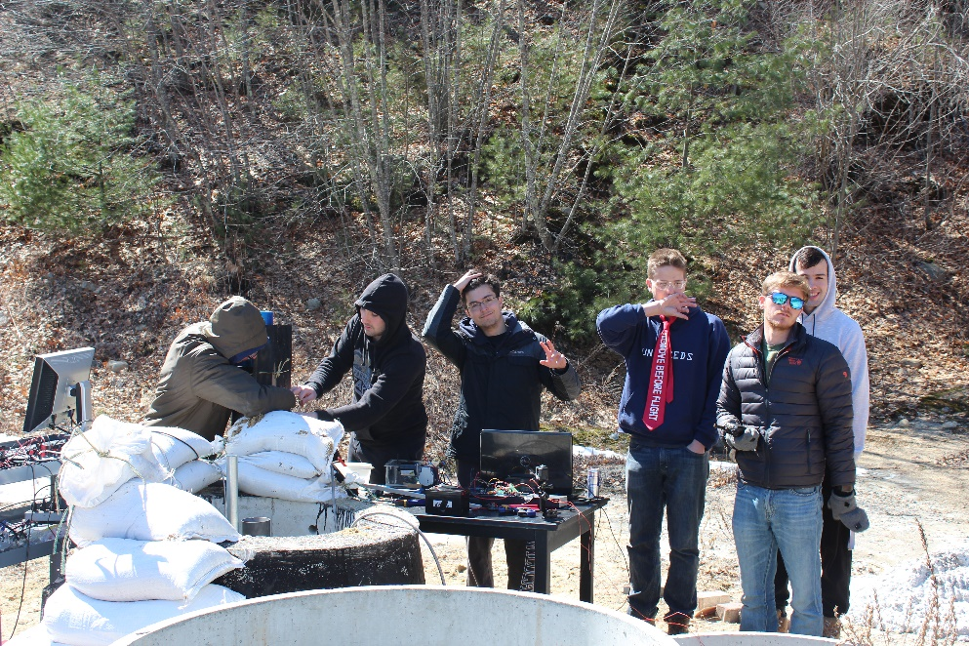
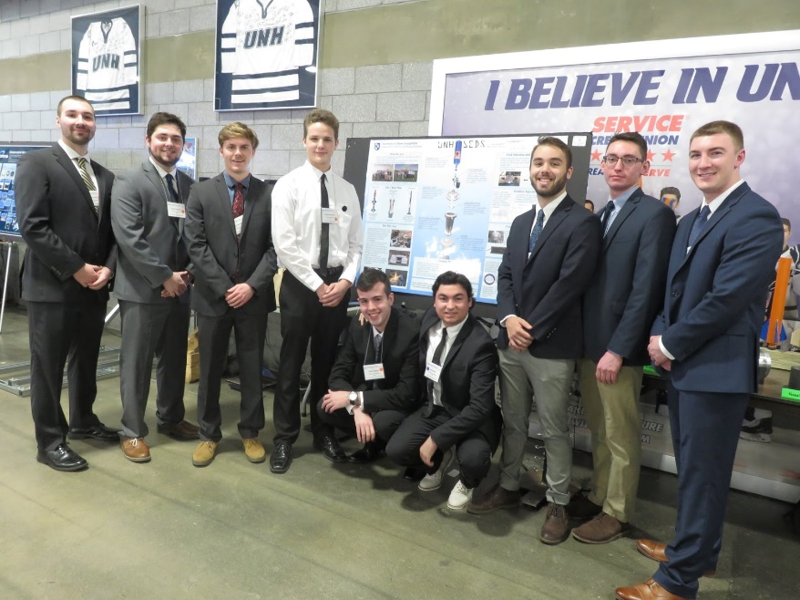
What is UNH SEDS?
UNH SEDS (Students for the Exploration and Development of Space)
Competing in the 2020 Spaceport America Cup Competition, located in New Mexico
Collegiate Rocketry Organization
Founded in the Spring of 2017
University of New Hampshire
Students for the Exploration and Development of Space
Notes:
Seds is a naitionwide organization that allows colleges from around the world to start a chapter. Although we are allowed to do whatever we would like as an organization, they do sponsor competition for SEDS groups as well as national conferences, the next one for the beginning of November. We are a team comprised of many majors and all classes, so applying to join our team would not only be a senior project, but an interdisciplinary experience.

Slide 3
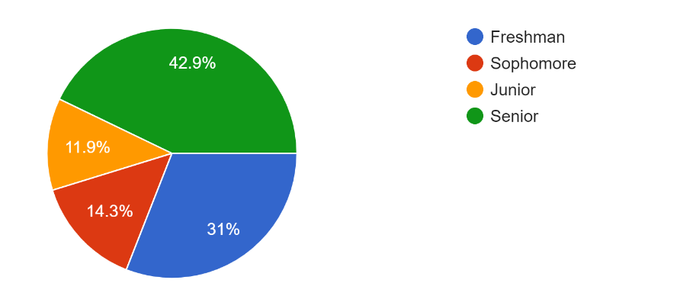
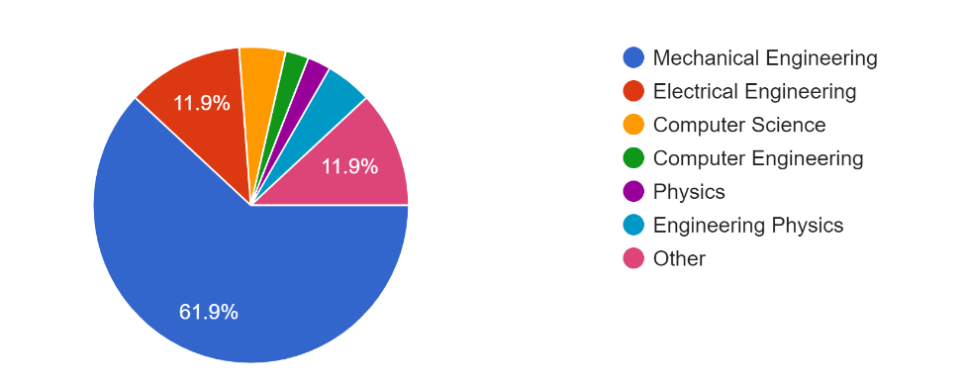
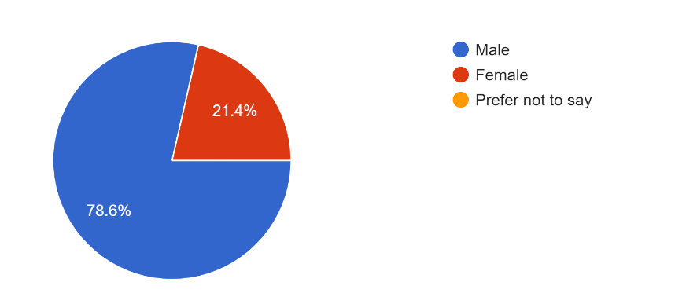
Who is UNH SEDS?
Year
Major
Membership
University of New Hampshire
Students for the Exploration and Development of Space
Notes:
Seds is a naitionwide organization that allows colleges from around the world to start a chapter. Although we are allowed to do whatever we would like as an organization, they do sponsor competition for SEDS groups as well as national conferences, the next one for the beginning of November. We are a team comprised of many majors and all classes, so applying to join our team would not only be a senior project, but an interdisciplinary experience.

Slide 4
https://www.youtube.com/channel/UCCGet3NkAJHD2hr-q8MuCUg
University of New Hampshire
Students for the Exploration and Development of Space

Slide 5








Project Overview
Students for the Exploration and Development of Space (SEDS)
Third year organization
Design and test a hybrid rocket
Applying rocket mechanics from last two years knowledge
Build, test, analyze, optimize
Spaceport America Cup - June 2020 in Las Cruces, New Mexico
Student researched and developed hybrid class
Target apogee 10,000 feet
University of New Hampshire
Students for the Exploration and Development of Space

Slide 6
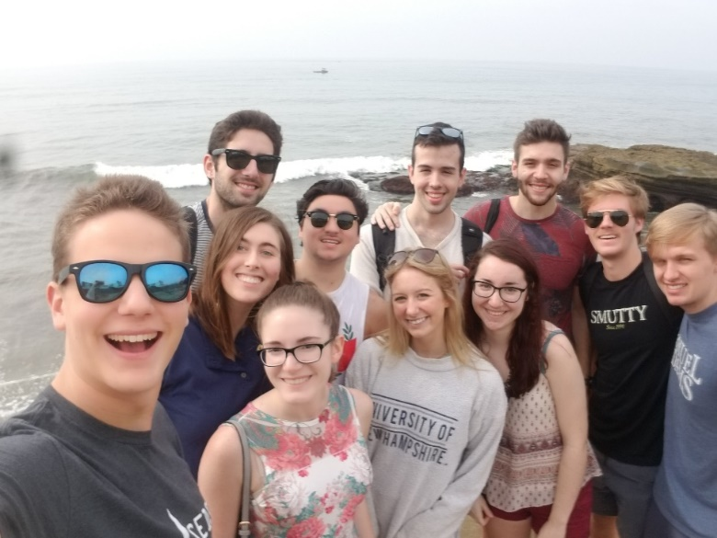
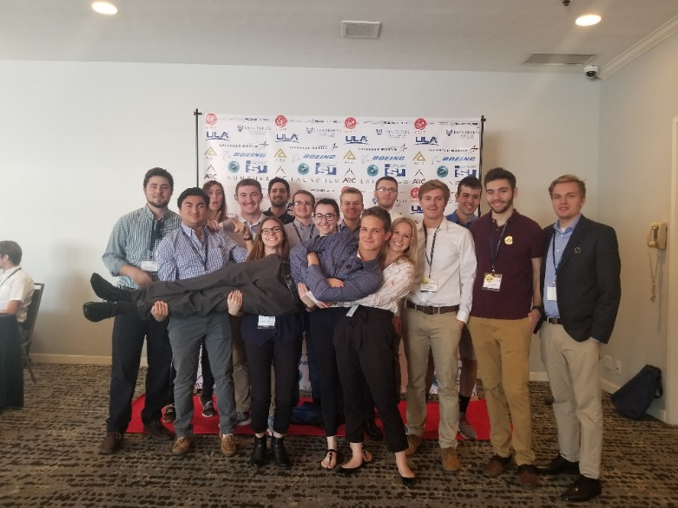
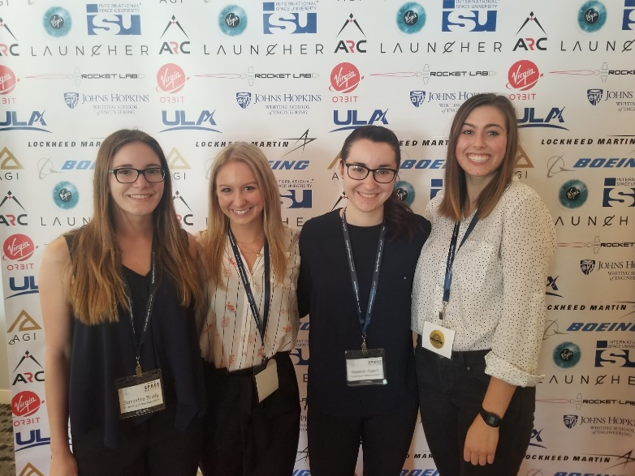
SpaceVision Conference
SEDS USA hosts a national conference every year called ‘SpaceVision’ where many of the various SEDS chapters congregate to network and listen to speakers.
November 2019 in Arizona State University.
November 2018, UNH SEDS brought 16 of its members to take part in the 2018 SpaceVision located in San Diego California.
University of New Hampshire
Students for the Exploration and Development of Space

Slide 7

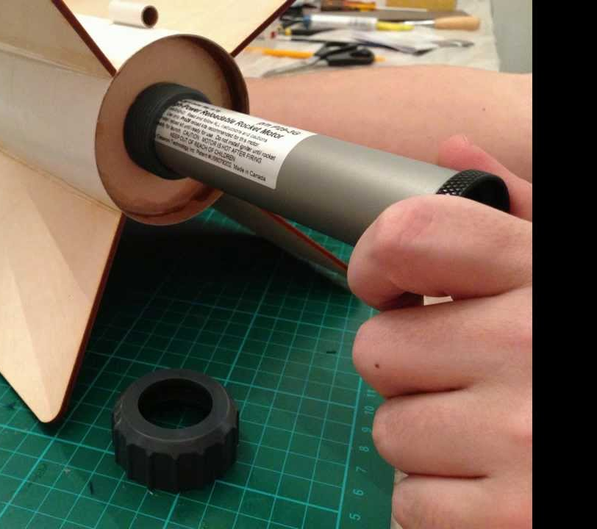


Community Engagement
SEDS Yuri’s Night!
Rocket Building Workshops
Aerospace Opportunity Presentations
Hybrid Rocket Presentation
Quadcopter Presentation
Matthew Isakowitz Presentation
University of New Hampshire
Students for the Exploration and Development of Space

